Slide 1
Backpropagation Algorithm for deep Neural Networks

Slide 2

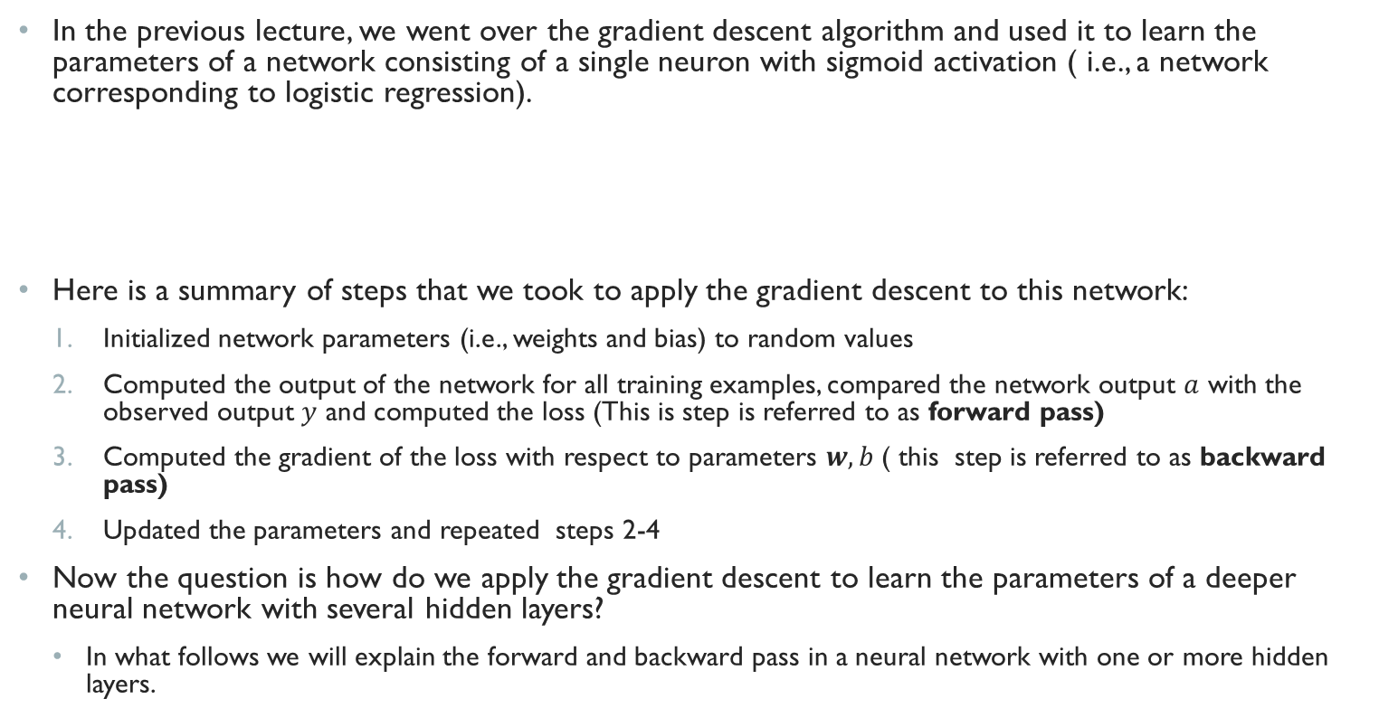


Gradient descent for a feedforward deep neural network
In the previous lecture, we went over the gradient descent algorithm and used it to learn the parameters of a network consisting of a single neuron with sigmoid activation ( i.e., a network corresponding to logistic regression).
Here is a summary of steps that we took to apply the gradient descent to this network:
Initialized network parameters (i.e., weights and bias) to random values
Computed the output of the network for all training examples, compared the network output $a$ with the observed output $y$ and computed the loss (This is step is referred to as forward pass)
Computed the gradient of the loss with respect to parameters $w,b$( this step is referred to as backward pass)
Updated the parameters and repeated steps 2-4
Now the question is how do we apply the gradient descent to learn the parameters of a deeper neural network with several hidden layers?
In what follows we will explain the forward and backward pass in a neural network with one or more hidden layers.
$$x=<x_{1},x_{2}>$$
$<w$,b>
$$a$$

Slide 3
Forward pass

Slide 4

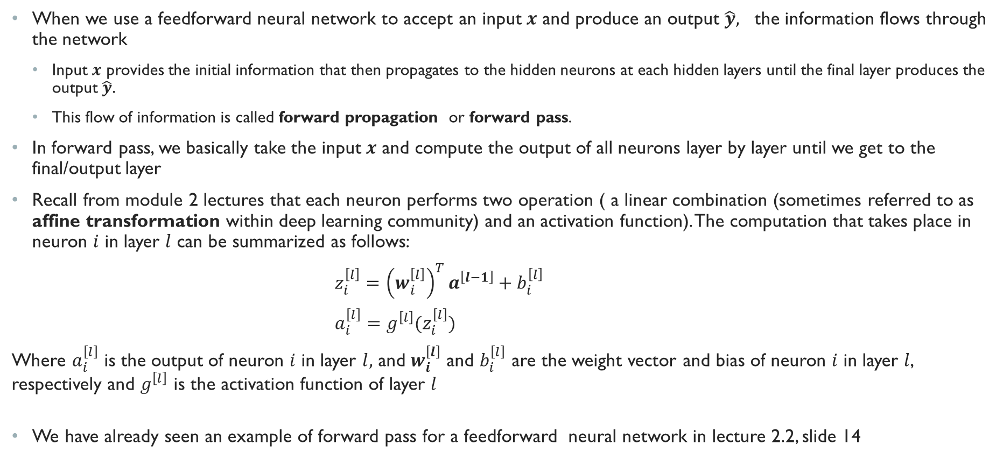


Forward pass: Computing the output of the network
When we use a feedforward neural network to accept an input $x$ and produce an output $\hat{y},$ the information flows through the network
Input $x$ provides the initial information that then propagates to the hidden neurons at each hidden layers until the final layer produces the output $\hat{y}.$
This flow of information is called forward propagation or forward pass.
In forward pass, we basically take the input $x$ and compute the output of all neurons layer by layer until we get to the final/output layer
Recall from module 2 lectures that each neuron performs two operation ( a linear combination (sometimes referred to as affine transformation within deep learning community) and an activation function). The computation that takes place in neuron $i$ in layer $l$ can be summarized as follows:
$z_{i}^{\left[l\right]}={\left(w_{i}^{\left[l\right]}\right)}^{T}a^{\left[l−1\right]}+b_{i}^{\left[l\right]}$
$a_{i}^{\left[l\right]}=g^{\left[l\right]}(z_{i}^{\left[l\right]})$
Where $a_{i}^{\left[l\right]}$ is the output of neuron $i$ in layer $l,$ and $w_{i}^{\left[l\right]}$ and $b_{i}^{\left[l\right]}$ are the weight vector and bias of neuron $i$ in layer $l$, respectively and $g^{\left[l\right]}$ is the activation function of layer $l$
We have already seen an example of forward pass for a feedforward neural network in lecture 2.2, slide 14
$$a^{\left[l−1\right]}$$
$$<w_{i}^{\left[l\right]},b_{i}^{\left[l\right]}>$$
$$a_{i}^{\left[l\right]}$$

Slide 5
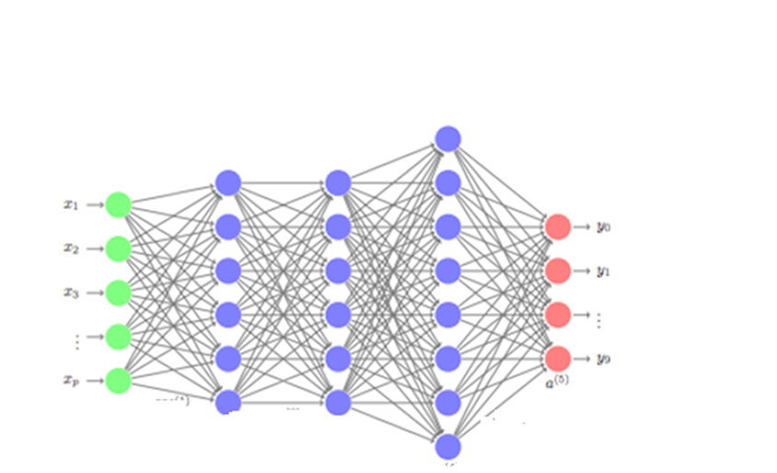
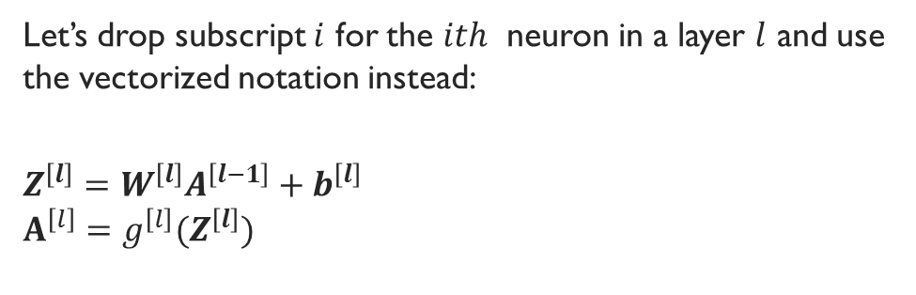




Forward pass Cont.
Let’s drop subscript $i$ for the $ith$ neuron in a layer $l$ and use the vectorized notation instead:
$$Z^{\left[l\right]}=W^{\left[l\right]}A^{\left[l−1\right]}+b^{\left[l\right]}$$
$$A^{\left[l\right]}=g^{\left[l\right]}(Z^{\left[l\right]})$$
Forward pass
$$Z^{\left[2\right]}=W^{\left[2\right]}A^{\left[1\right]}+b^{\left[2\right]}$$
$$A^{\left[2\right]}=g^{\left[2\right]}(Z^{\left[2\right]})$$
$$Z^{\left[3\right]}=W^{\left[3\right]}A^{\left[2\right]}+b^{\left[3\right]}$$
$$A^{\left[3\right]}=g^{\left[3\right]}(Z^{\left[3\right]})$$
$$Z^{\left[1\right]}=W^{\left[1\right]}X+b^{\left[1\right]}$$
$$A^{\left[l\right]}=g^{\left[l\right]}(Z^{\left[l\right]})$$
$$Z^{\left[4\right]}=W^{\left[4\right]}A^{\left[3\right]}+b^{\left[4\right]}$$
$$\hat{Y}=g^{\left[4\right]}(Z^{\left[4\right]})$$

Slide 6
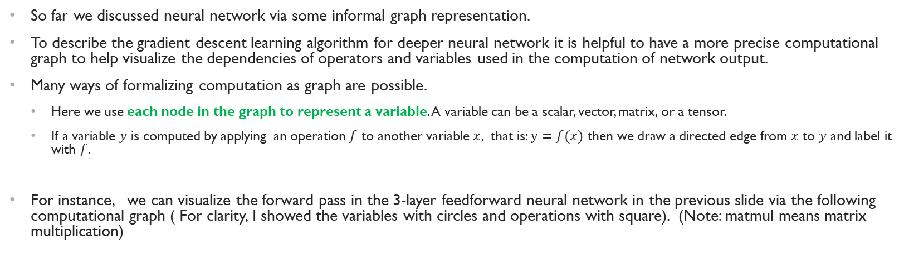



Computational graph of the forward pass
So far we discussed neural network via some informal graph representation.
To describe the gradient descent learning algorithm for deeper neural network it is helpful to have a more precise computational graph to help visualize the dependencies of operators and variables used in the computation of network output.
Many ways of formalizing computation as graph are possible.
Here we use each node in the graph to represent a variable. A variable can be a scalar, vector, matrix, or a tensor.
If a variable $y$ is computed by applying an operation $f$ to another variable $x,$ that is: $y=f(x)$ then we draw a directed edge from $x$ to $y$ and label it with $f$.
For instance, we can visualize the forward pass in the 3-layer feedforward neural network in the previous slide via the following computational graph ( For clarity, I showed the variables with circles and operations with square). (Note: matmul means matrix multiplication)
$$x$$
$$f$$
$$y$$
Network output
Network input
Forward pass

Slide 7
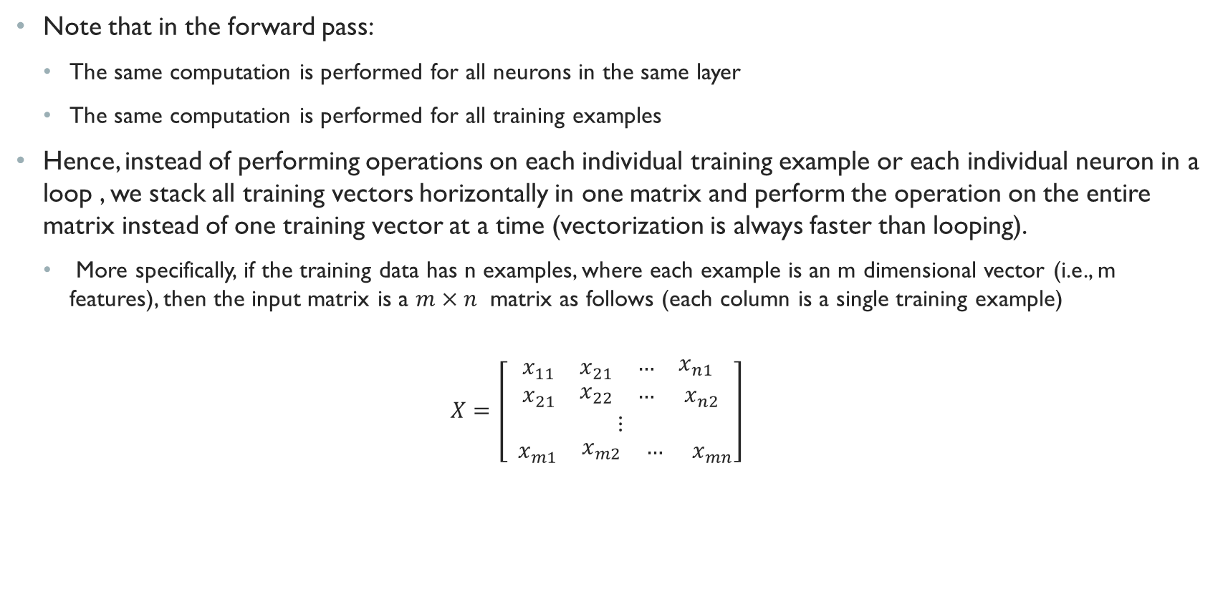
Matrix Operations in forward pass
Note that in the forward pass:
The same computation is performed for all neurons in the same layer
The same computation is performed for all training examples
Hence, instead of performing operations on each individual training example or each individual neuron in a loop , we stack all training vectors horizontally in one matrix and perform the operation on the entire matrix instead of one training vector at a time (vectorization is always faster than looping).
More specifically, if the training data has n examples, where each example is an m dimensional vector (i.e., m features), then the input matrix is a $m×n$ matrix as follows (each column is a single training example)
$$X=\left[\begin{aligned}\begin{matrix}x_{11} & x_{21} & \begin{matrix}… & x_{n1}\end{matrix}\end{matrix} \\ \begin{matrix}x_{21} & \begin{matrix}x_{22} & … \end{matrix} & x_{n2}\end{matrix} \\ ⋮ \\ \begin{matrix}{ x}_{m1} & \begin{matrix}x_{m2} & … \end{matrix} & x_{mn}\end{matrix}\end{aligned}\right]$$
First training example

Slide 8

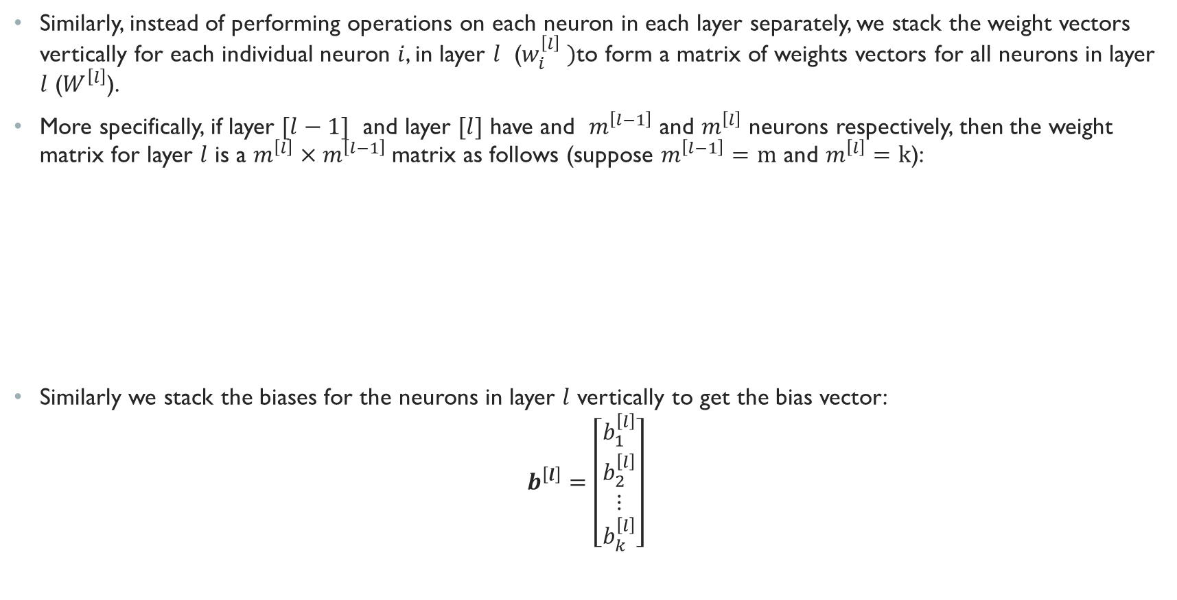

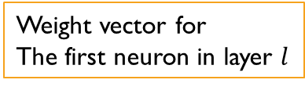
Matrix Operations in forward pass (Cont.)
Similarly, instead of performing operations on each neuron in each layer separately, we stack the weight vectors vertically for each individual neuron $i$, in layer $l$ ($w_{i}^{\left[l\right]} )$to form a matrix of weights vectors for all neurons in layer $l$ ($W^{\left[l\right]}$).
More specifically, if layer $[l−1]$ and layer $[l]$ have and $m^{\left[l−1\right]}$ and $m^{\left[l\right]}$ neurons respectively, then the weight matrix for layer $l$ is a $m^{\left[l\right]}×m^{\left[l−1\right]}$matrix as follows (suppose $m^{\left[l−1\right]}=m$ and $m^{\left[l\right]}=k$):
Similarly we stack the biases for the neurons in layer $l$ vertically to get the bias vector:
$$b^{\left[l\right]}=\left[\begin{matrix}b_{1}^{\left[l\right]} \\ b_{2}^{\left[l\right]} \\ \begin{aligned}⋮ \\ b_{k}^{\left[l\right]}\end{aligned}\end{matrix}\right]$$
$$W^{\left[l\right]}=\left[\begin{matrix}w_{1}^{\left[l\right]} \\ w_{2}^{\left[l\right]} \\ \begin{aligned}⋮ \\ w_{k}^{\left[l\right]}\end{aligned}\end{matrix}\right]\left[\begin{aligned}\begin{matrix}w_{11}^{\left[l\right]} & w_{12}^{\left[l\right]} & \begin{matrix}… & w_{1m}^{\left[l\right]}\end{matrix}\end{matrix} \\ \begin{matrix}w_{12}^{\left[l\right]} & \begin{matrix}w_{22}^{\left[l\right]} & … \end{matrix} & w_{2m}^{\left[l\right]}\end{matrix} \\ ⋮ \\ \begin{matrix}w_{k1}^{\left[l\right]} & \begin{matrix}w_{k2}^{\left[l\right]} & … \end{matrix} & w_{km}^{\left[l\right]}\end{matrix}\end{aligned}\right]$$
Weight vector for
The first neuron in layer $l$
Bias of the first neuron in layer $l$

Slide 9
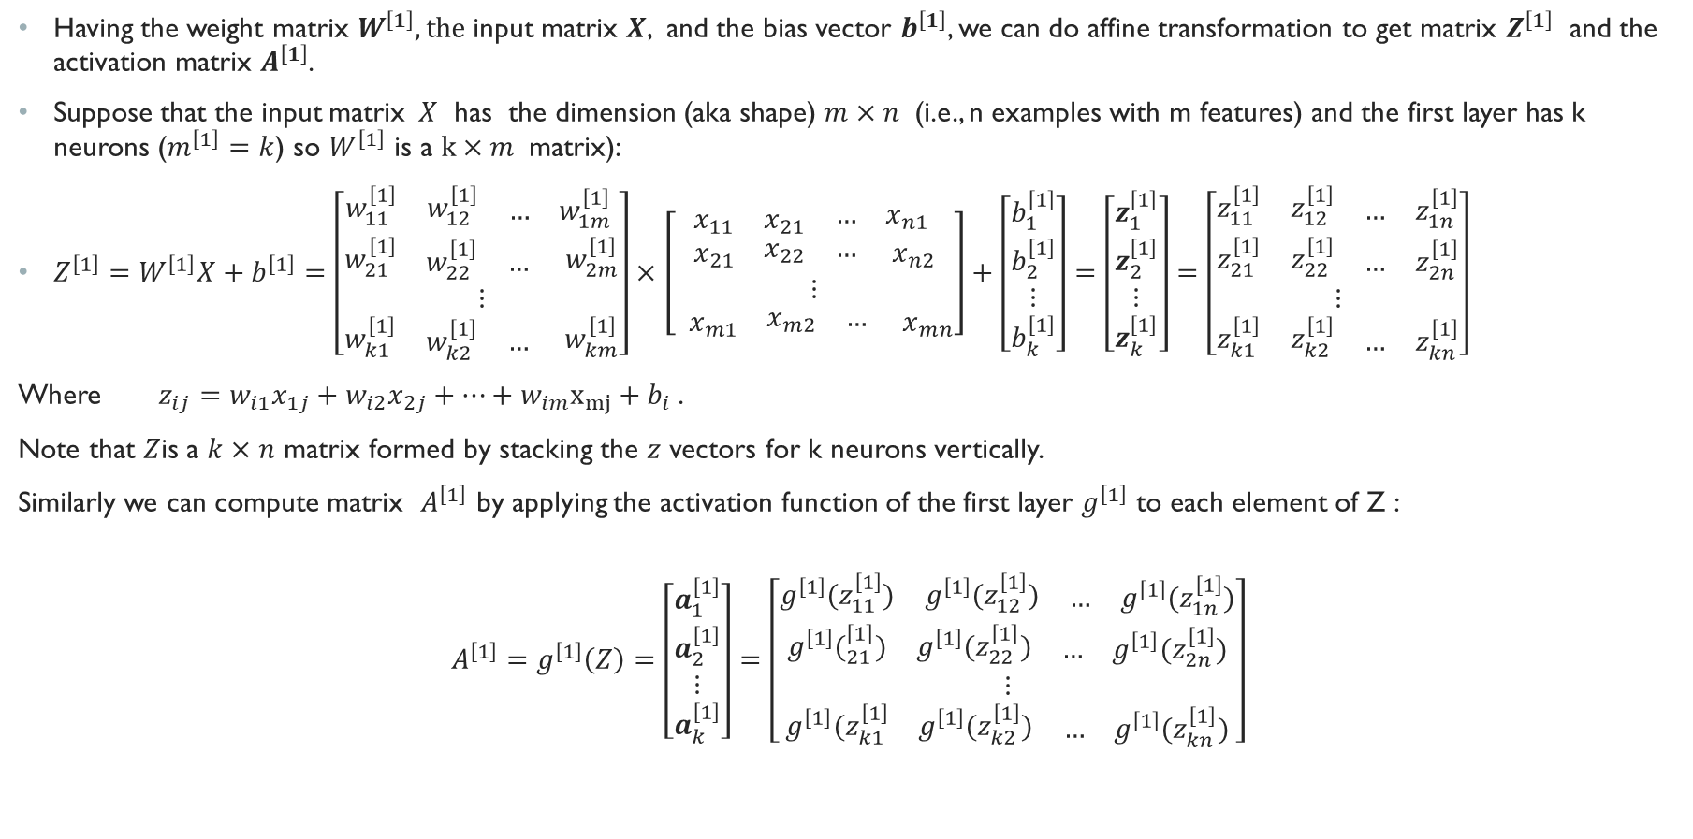

Matrix Operations in forward pass (Cont.)
Having the weight matrix $W^{\left[1\right]}, the$input matrix $X$, and the bias vector $b^{\left[1\right]}$, we can do affine transformation to get matrix $Z^{\left[1\right]}$ and the activation matrix $A^{\left[1\right]}$.
Suppose that the input matrix$X$ has the dimension (aka shape) $m×n$ (i.e., n examples with m features) and the first layer has k neurons ($m^{\left[1\right]}=k$) so $W^{\left[1\right]}$ is a $k×m$ matrix):
$Z^{\left[1\right]}=W^{\left[1\right]}X+b^{\left[1\right]}=\left[\begin{aligned}\begin{matrix}w_{11}^{\left[1\right]} & w_{12}^{\left[1\right]} & \begin{matrix}… & w_{1m}^{\left[1\right]}\end{matrix}\end{matrix} \\ \begin{matrix}w_{21}^{\left[1\right]} & \begin{matrix}w_{22}^{\left[1\right]} & … \end{matrix} & w_{2m}^{\left[1\right]}\end{matrix} \\ ⋮ \\ \begin{matrix}w_{k1}^{\left[1\right]} & \begin{matrix}w_{k2}^{\left[1\right]} & … \end{matrix} & w_{km}^{\left[1\right]}\end{matrix}\end{aligned}\right]×\left[\begin{aligned}\begin{matrix}x_{11} & x_{21} & \begin{matrix}… & x_{n1}\end{matrix}\end{matrix} \\ \begin{matrix}x_{21} & \begin{matrix}x_{22} & … \end{matrix} & x_{n2}\end{matrix} \\ ⋮ \\ \begin{matrix}{ x}_{m1} & \begin{matrix}x_{m2} & … \end{matrix} & x_{mn}\end{matrix}\end{aligned}\right]+\left[\begin{matrix}b_{1}^{\left[1\right]} \\ b_{2}^{\left[1\right]} \\ \begin{aligned}⋮ \\ b_{k}^{\left[1\right]}\end{aligned}\end{matrix}\right]=\left[\begin{matrix}z_{1}^{\left[1\right]} \\ z_{2}^{\left[1\right]} \\ \begin{aligned}⋮ \\ z_{k}^{\left[1\right]}\end{aligned}\end{matrix}\right]=\left[\begin{matrix}\begin{matrix}z_{11}^{\left[1\right]} & z_{12}^{\left[1\right]} & \begin{matrix}… & z_{1n}^{\left[1\right]}\end{matrix}\end{matrix} \\ \begin{matrix}z_{21}^{\left[1\right]} & z_{22}^{\left[1\right]} & \begin{matrix}… & z_{2n}^{\left[1\right]}\end{matrix}\end{matrix} \\ \begin{aligned}⋮ \\ \begin{matrix}z_{k1}^{\left[1\right]} & z_{k2}^{\left[1\right]} & \begin{matrix}… & z_{kn}^{\left[1\right]}\end{matrix}\end{matrix}\end{aligned}\end{matrix}\right]$
Where $z_{ij}=w_{i1}x_{1j}+w_{i2}x_{2j}+…+w_{im}x_{mj}+b_{i}$.
Note that $Z$is a $k×n$ matrix formed by stacking the $z$ vectors for k neurons vertically.
Similarly we can compute matrix $A^{\left[1\right]}$ by applying the activation function of the first layer $g^{\left[1\right]}$ to each element of Z :
$$A^{\left[1\right]}=g^{\left[1\right]}\left(Z\right)=\left[\begin{matrix}a_{1}^{\left[1\right]} \\ a_{2}^{\left[1\right]} \\ \begin{aligned}⋮ \\ a_{k}^{\left[1\right]}\end{aligned}\end{matrix}\right]=\left[\begin{matrix}\begin{matrix}{g^{\left[1\right]}(z}_{11}^{\left[1\right]}) & {g^{\left[1\right]}(z}_{12}^{\left[1\right]}) & \begin{matrix}… & g^{\left[1\right]}(z_{1n}^{\left[1\right]})\end{matrix}\end{matrix} \\ \begin{matrix}{g^{\left[1\right]}(}_{21}^{\left[1\right]}) & {g^{\left[1\right]}(z}_{22}^{\left[1\right]}) & \begin{matrix}… & {g^{\left[1\right]}(z}_{2n}^{\left[1\right]})\end{matrix}\end{matrix} \\ \begin{aligned}⋮ \\ \begin{matrix}{g^{\left[1\right]}(z}_{k1}^{\left[1\right]} & {g^{\left[1\right]}(z}_{k2}^{\left[1\right]}) & \begin{matrix}… & {g^{\left[1\right]}(z}_{kn}^{\left[1\right]})\end{matrix}\end{matrix}\end{aligned}\end{matrix}\right]$$
$z$ vector(affine transformation) for the first neuron in layer l fir each training example
Output of the first neuron in layer 1 for each training example

Slide 10
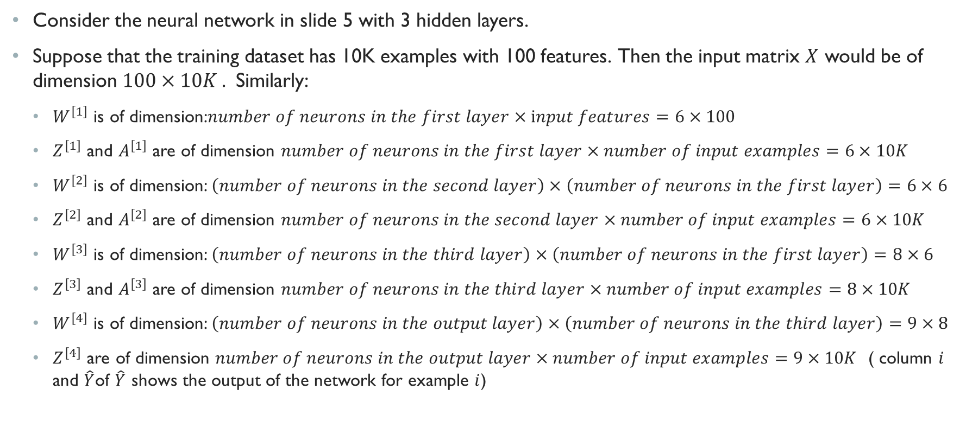
Matrix Operations in forward pass Example
Consider the neural network in slide 5 with 3 hidden layers.
Suppose that the training dataset has 10K examples with 100 features. Then the input matrix $X$ would be of dimension $100×10K$. Similarly:
$W^{\left[1\right]}$ is of dimension:$number of neurons in the first layer×input features=6×100$
$Z^{\left[1\right]}$ and $A^{\left[1\right]}$ are of dimension $number of neurons in the first layer×number of input examples=6×10K$
$W^{\left[2\right]}$ is of dimension: $\left(number of neurons in the second layer\right)×\left(number of neurons in the first layer\right)=6×6$
$Z^{\left[2\right]}$ and $A^{\left[2\right]}$ are of dimension $number of neurons in the second layer×number of input examples=6×10K$
$W^{\left[3\right]}$ is of dimension: $\left(number of neurons in the third layer\right)×\left(number of neurons in the first layer\right)=8×6$
$Z^{\left[3\right]}$ and $A^{\left[3\right]}$ are of dimension $number of neurons in the third layer×number of input examples=8×10K$
$W^{\left[4\right]}$ is of dimension: $\left(number of neurons in the output layer\right)×\left(number of neurons in the third layer\right)=9×8$
$Z^{\left[4\right]}$ are of dimension $number of neurons in the output layer×number of input examples=9×10K$ ( column $i$ and $\hat{Y}$of $\hat{Y}$ shows the output of the network for example $i$)

Slide 11
Backward pass

Slide 12
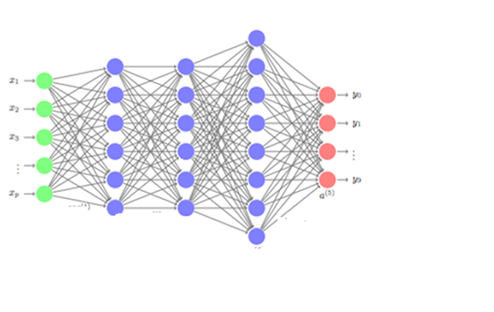




Chaining derivatives: Backpropagation algorithm
The backpropagation algorithm also called backprop allows the information from the loss function to flow backwards through the network to compute the gradients.
The backpropagation provides an efficient and simple procedure to compute a chain of gradients.
In neural networks, the backpropagation starts with the final loss value and works backward layer by layer, all the way to the first layer and computes a chain of gradients.
These gradients are then used in the gradient descent algorithm to update the network parameters ( i.e., the weights and biases of neurons).
Forward pass
$\frac{∂L}{∂W^{\left[4\right]}}$, $\frac{∂L}{∂b^{\left[4\right]}}$
$\frac{∂L}{∂W^{\left[1\right]}}$, $\frac{∂L}{∂b^{\left[1\right]}}$
$\frac{∂L}{∂W^{\left[2\right]}}$, $\frac{∂L}{∂b^{\left[2\right]}}$
$\frac{∂L}{∂W^{\left[3\right]}}$, $\frac{∂L}{∂b^{\left[3\right]}}$
Backward pass computing gradients

Slide 13
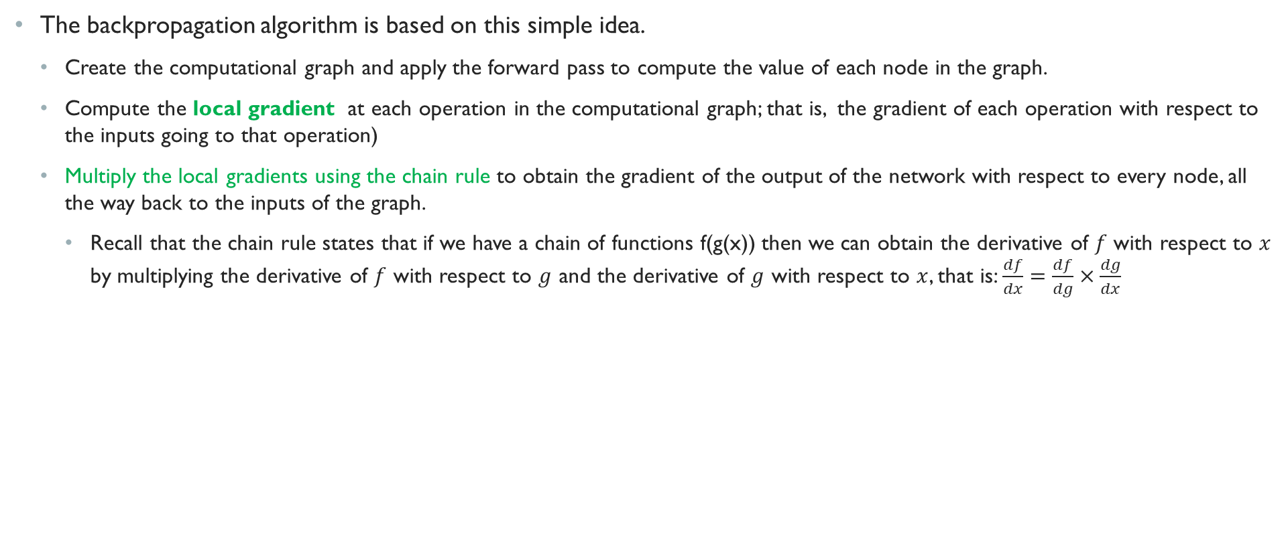
BackProp Intuition
The backpropagation algorithm is based on this simple idea.
Create the computational graph and apply the forward pass to compute the value of each node in the graph.
Compute the local gradient at each operation in the computational graph; that is, the gradient of each operation with respect to the inputs going to that operation)
Multiply the local gradients using the chain rule to obtain the gradient of the output of the network with respect to every node, all the way back to the inputs of the graph.
Recall that the chain rule states that if we have a chain of functions f(g(x)) then we can obtain the derivative of $f$ with respect to $x$ by multiplying the derivative of $f$ with respect to $g$ and the derivative of $g$ with respect to $x$, that is: $\frac{df}{dx}=\frac{df}{dg}×\frac{dg}{dx}$

Slide 14



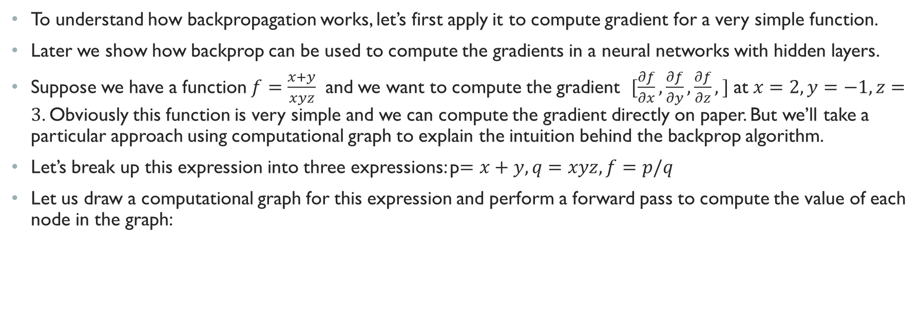










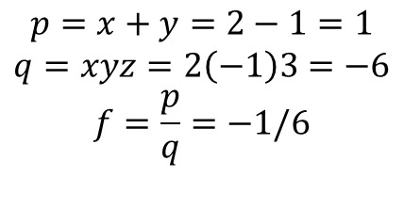


Backprop Intuition
To understand how backpropagation works, let’s first apply it to compute gradient for a very simple function.
Later we show how backprop can be used to compute the gradients in a neural networks with hidden layers.
Suppose we have a function $f=\frac{x+y}{xyz}$ and we want to compute the gradient $[\frac{∂f}{∂x},\frac{∂f}{∂y},\frac{∂f}{∂z},]$ at $x=2, y=−1, z=3$. Obviously this function is very simple and we can compute the gradient directly on paper. But we’ll take a particular approach using computational graph to explain the intuition behind the backprop algorithm.
Let’s break up this expression into three expressions: p$=x+y, q=xyz, f=p/q$
Let us draw a computational graph for this expression and perform a forward pass to compute the value of each node in the graph:
$$1$$
$$−\frac{1}{6}$$
$$+$$
$$p$$
$$/$$
$$f$$
$$2$$
$$x$$
$$−1$$
$$y$$
$$−6$$
$$p=x+y=2−1=1$$
$$q=xyz=2\left(−1\right)3=−6$$
$$f=\frac{p}{q}=−1/6$$
$$q$$
$$3$$
$$×$$
$$z$$

Slide 15
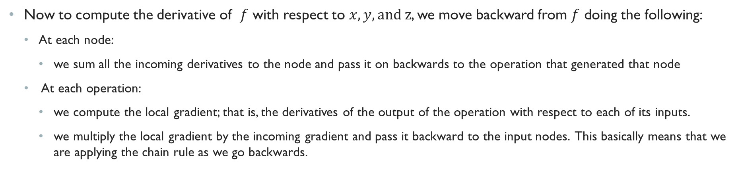
Backprop Intuition Cont.
Now to compute the derivative of $f$ with respect to $x,y, and z$, we move backward from $f$ doing the following:
At each node:
we sum all the incoming derivatives to the node and pass it on backwards to the operation that generated that node
At each operation:
we compute the local gradient; that is, the derivatives of the output of the operation with respect to each of its inputs.
we multiply the local gradient by the incoming gradient and pass it backward to the input nodes. This basically means that we are applying the chain rule as we go backwards.

Slide 16
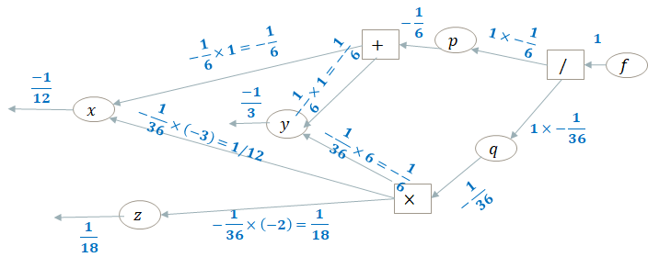
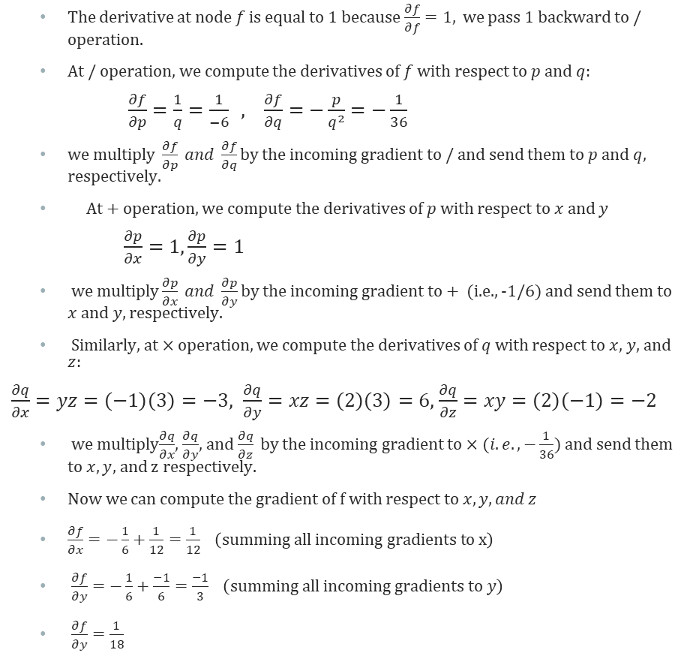
Backprop Intuition Cont.
The derivative at node $f$ is equal to 1 because $\frac{∂f}{∂f}=1,$ we pass 1 backward to / operation.
At / operation, we compute the derivatives of $f$ with respect to $p$ and $q:$
$\frac{∂f}{∂p}=\frac{1}{q}=\frac{1}{−6} , \frac{∂f}{∂q}=−\frac{p}{q^{2}}=−\frac{1}{36}$
we multiply $\frac{∂f}{∂p} and \frac{∂f}{∂q}$ by the incoming gradient to / and send them to $p$ and $q$, respectively.
At + operation, we compute the derivatives of $p$ with respect to $x$ and $y$
$\frac{∂p}{∂x}=1,\frac{∂p}{∂y}=1$
we multiply $\frac{∂p}{∂x} and \frac{∂p}{∂y}$ by the incoming gradient to + (i.e., -1/6) and send them to $x$ and $y$, respectively.
Similarly, at $×$ operation, we compute the derivatives of $q$ with respect to $x,$ $y,$ and $z:$
$\frac{∂q}{∂x}=yz=\left(−1\right)\left(3\right)=−3, \frac{∂q}{∂y}=xz=\left(2\right)\left(3\right)=6,$ $\frac{∂q}{∂z}=xy=\left(2\right)\left(−1\right)=−2$
we multiply$\frac{∂q}{∂x}$, $\frac{∂q}{∂y}$, and $\frac{∂q}{∂z}$ by the incoming gradient to $×(i.e., −\frac{1}{36})$ and send them to $x,y$, and z respectively.
Now we can compute the gradient of f with respect to $x,y, and z$
$\frac{∂f}{∂x}=−\frac{1}{6}+\frac{1}{12}=\frac{1}{12} \left(summing all incoming gradients to x\right)$
$\frac{∂f}{∂y}=−\frac{1}{6}+\frac{−1}{6}=\frac{−1}{3} \left(summing all incoming gradients to y\right)$
$\frac{∂f}{∂y}=\frac{1}{18}$

Slide 17
Why backprop?
You can compute the gradients on paper with respect to every variable; however,
It is very tedious
If you make a change to the loss function or an activation function of a neuron, then you have to re-compute everything
Computing gradient by hand is not feasible for very complex models
Backpropagation allows deep learning programming frameworks such as tensorflow, pytorch, theano, etc. to automatically and efficiently compute the gradients of the loss functions with respect to all the parameters in the network.
Backprop caches the intermediate gradients along the way so they don’t need to be recomputed each time.

Slide 18
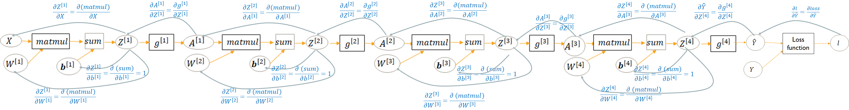
BackProp In Neural networks: Computing the local gradients
The backprop for neural networks works much the same as the simple example we just discussed except that in a neural network, we need to compute derivatives with respect to vectors instead of scalars and subsequently apply the chain rules to vectors.
We start from the loss function and move backward in the computational graph computing the local gradient of each operation and multiplying the local gradients along the way to compute the gradient of loss with respect to each node.
For instance, the following figure shows the local gradients that need to be computed in the backward pass for computational graph of the four-layered feedforward network in slide 12.

Slide 19
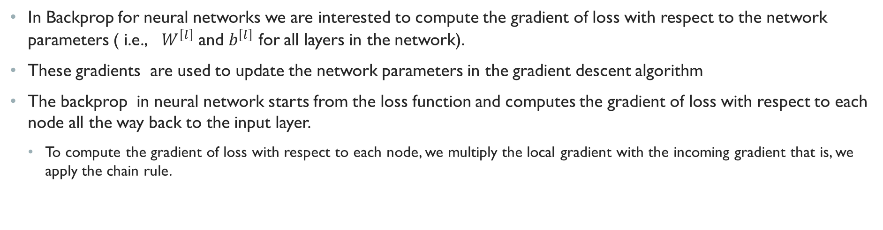
BackProp in Neural networks: Chaining the gradients
In Backprop for neural networks we are interested to compute the gradient of loss with respect to the network parameters ( i.e., $W^{\left[l\right]}$ and $b^{\left[l\right]}$ for all layers in the network).
These gradients are used to update the network parameters in the gradient descent algorithm
The backprop in neural network starts from the loss function and computes the gradient of loss with respect to each node all the way back to the input layer.
To compute the gradient of loss with respect to each node, we multiply the local gradient with the incoming gradient that is, we apply the chain rule.

Slide 20
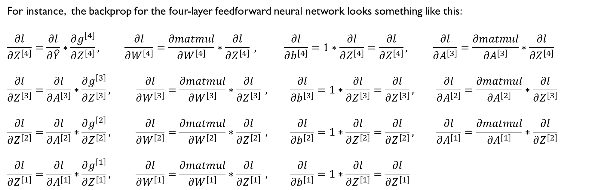
Backprop in neural networks Example
For instance, the backprop for the four-layer feedforward neural network looks something like this:
$$\frac{∂l}{∂Z^{\left[4\right]}}=\frac{∂l}{∂\hat{Y}}∗\frac{∂g^{\left[4\right]}}{∂Z^{\left[4\right]}}, \frac{∂l}{∂W^{\left[4\right]}}=\frac{∂matmul}{∂W^{\left[4\right]}}∗\frac{∂l}{∂Z^{\left[4\right]}} , \frac{∂l}{∂b^{\left[4\right]}}=1∗\frac{∂l}{∂Z^{\left[4\right]}}=\frac{∂l}{∂Z^{\left[4\right]}}, \frac{∂l}{∂A^{\left[3\right]}}=\frac{∂matmul}{∂A^{\left[3\right]}}∗\frac{∂l}{∂Z^{\left[4\right]}}$$
$$\frac{∂l}{∂Z^{\left[3\right]}}=\frac{∂l}{∂A^{\left[3\right]}}∗\frac{∂g^{\left[3\right]}}{∂Z^{\left[3\right]}}, \frac{∂l}{∂W^{\left[3\right]}}=\frac{∂matmul}{∂W^{\left[3\right]}}∗\frac{∂l}{∂Z^{\left[3\right]}} , \frac{∂l}{∂b^{\left[3\right]}}=1∗\frac{∂l}{∂Z^{\left[3\right]}}=\frac{∂l}{∂Z^{\left[3\right]}}, \frac{∂l}{∂A^{\left[2\right]}}=\frac{∂matmul}{∂A^{\left[2\right]}}∗\frac{∂l}{∂Z^{\left[3\right]}}$$
$$\frac{∂l}{∂Z^{\left[2\right]}}=\frac{∂l}{∂A^{\left[2\right]}}∗\frac{∂g^{\left[2\right]}}{∂Z^{\left[2\right]}}, \frac{∂l}{∂W^{\left[2\right]}}=\frac{∂matmul}{∂W^{\left[2\right]}}∗\frac{∂l}{∂Z^{\left[2\right]}} , \frac{∂l}{∂b^{\left[2\right]}}=1∗\frac{∂l}{∂Z^{\left[2\right]}}=\frac{∂l}{∂Z^{\left[2\right]}}, \frac{∂l}{∂A^{\left[1\right]}}=\frac{∂matmul}{∂A^{\left[1\right]}}∗\frac{∂l}{∂Z^{\left[2\right]}}$$
$$\frac{∂l}{∂Z^{\left[1\right]}}=\frac{∂l}{∂A^{\left[1\right]}}∗\frac{∂g^{\left[1\right]}}{∂Z^{\left[1\right]}}, \frac{∂l}{∂W^{\left[1\right]}}=\frac{∂matmul}{∂W^{\left[1\right]}}∗\frac{∂l}{∂Z^{\left[1\right]}} , \frac{∂l}{∂b^{\left[1\right]}}=1∗\frac{∂l}{∂Z^{\left[1\right]}}=\frac{∂l}{∂Z^{\left[1\right]}}$$

Slide 21
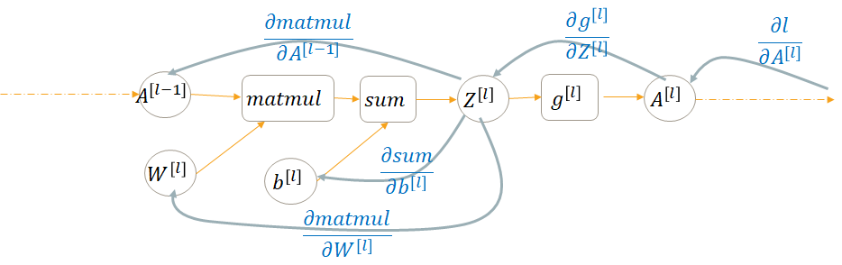

BackProp In feedforward neural networks with n layers
In general, the backprop in an n-layered neural network can be formulated as follows:
Where $l∈\{1,..,n\}$ and $A^{\left[0\right]}=X$ (the input to the network) and $A^{\left[n\right]}=\hat{Y}$ (output of the network)
$$\frac{∂l}{∂Z^{\left[l\right]}}=\frac{∂l}{∂A^{\left[l\right]}}∗\frac{∂g^{\left[l\right]}}{∂Z^{\left[l\right]}}, \frac{∂l}{∂W^{\left[l\right]}}=\frac{∂matmul}{∂W^{\left[l\right]}}∗\frac{∂l}{∂Z^{\left[l\right]}} , \frac{∂l}{∂b^{\left[l\right]}}=\frac{∂l}{∂Z^{\left[l\right]}}, \frac{∂l}{∂A^{\left[l−1\right]}}=\frac{∂matmul}{∂A^{\left[l\right]}}∗\frac{∂l}{∂Z^{\left[l\right]}}$$

Slide 22
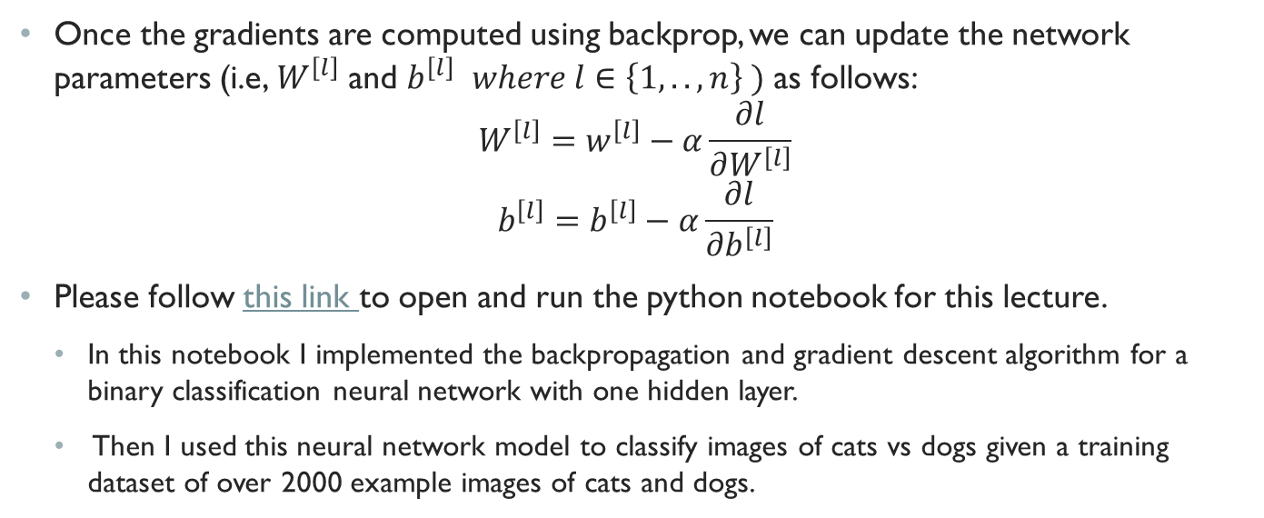
updating parameters Using gradient descent
Once the gradients are computed using backprop, we can update the network parameters (i.e, $W^{\left[l\right]}$ and $b^{\left[l\right]}$ $where l∈\left\{1,..,n\right\} )$ as follows:
$$W^{\left[l\right]}=w^{\left[l\right]}−α\frac{∂l}{∂W^{\left[l\right]}}$$
$$b^{\left[l\right]}=b^{\left[l\right]}−α\frac{∂l}{∂b^{\left[l\right]}}$$
Please follow this link to open and run the python notebook for this lecture.
In this notebook I implemented the backpropagation and gradient descent algorithm for a binary classification neural network with one hidden layer.
Then I used this neural network model to classify images of cats vs dogs given a training dataset of over 2000 example images of cats and dogs.

Slide 23
End of lecture

